Slide 1
PHC NURSE PRACTITIONER DEPARTMENT MEDICAL ADVISORY COMMITTEE – COUNCIL FOR EXCELLENCE
QUALITY REPORT
Dr. Stan Marchuk, DNP, MN, NP(F), CNeph(c), FAANP Karen Sims, MN-ACNP, NP(A)
Nurse Practitioner Department Head Nurse Practitioner – Adult Bleeding Disorders
Nurse Practitioner – Hemodialysis Program Nurse Practitioner Department – Quality Committee Chair
Adjunct Professor, UBC and UVIC – School of Nursing Adjunct Professor, UBC – School of Nursing

Slide 2
OVERVIEW
PHC Nurse Practitioner Department
Overview of the role
Background and members
Education
Clinical Programs
Quality Improvement and Research
Quality Assurance process of the BC College of Nurses and Midwives
Nurse Practitioner Department Quality Committee
Quality, Safety & Value Projects
Committee Work
Publications

Slide 3
OVERVIEW OF THE NURSE PRACTITIONER ROLE
Internationally
Initiated in 1965 in the USA
Introduced in Jamaica in the 1970’s
Followed by Botswana, the UK in the 1980’s and many other countries since (Australia, New Zealand, The Netherlands, Finland)
Nationally
Introduced in the early 1970’s
Provincially
Introduced in 2005, had been trialed in the 1980’s
Locally
PHC’s first NPs were in Orthopedics in 2005

Slide 4
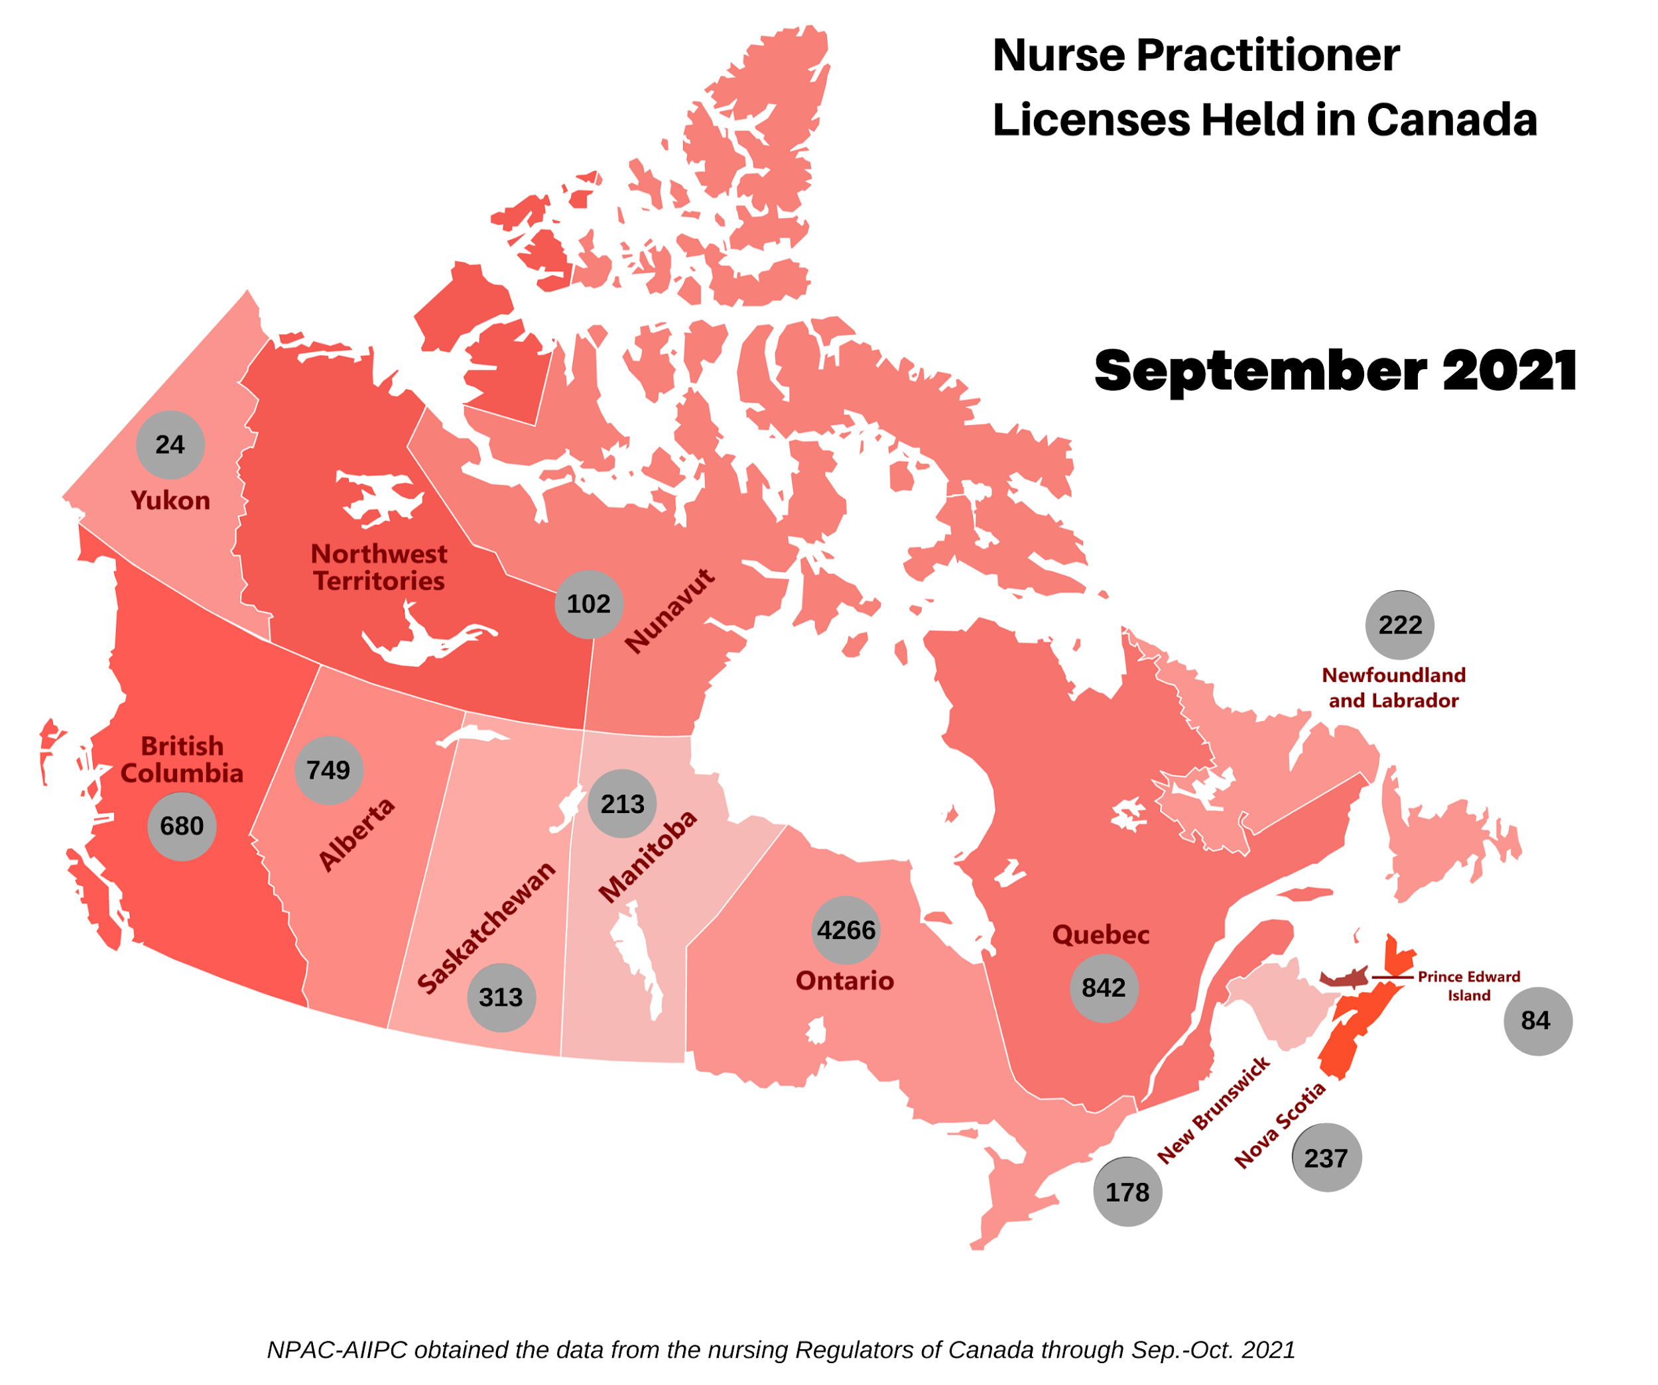
NURSE PRACTITIONERS BY PROVINCE

Slide 5
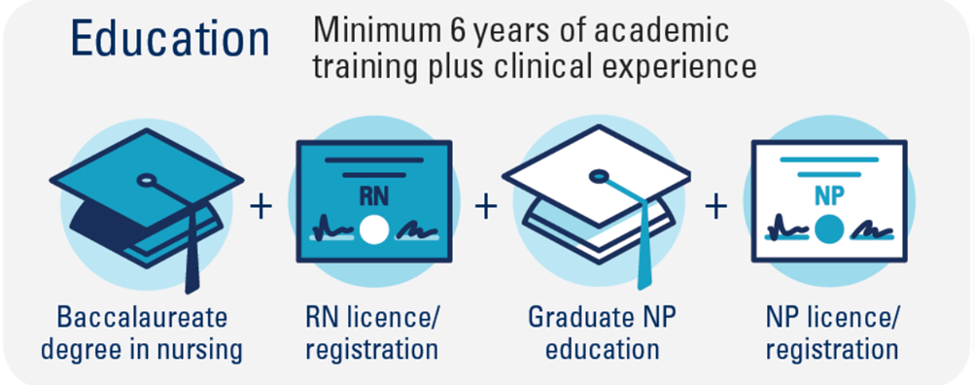
NURSE PRACTITIONER EDUCATION

Slide 6
NURSE PRACTITIONER PRACTICE
Regulated by British Columbia College of Nurses & Midwives
QA audit within 2 years of practice by college
Undergo annual quality assurance review
Require NPs to engage in QA activities to maintain licensure

Slide 7
NURSE PRACTITIONERS AT PHC
22 PHC Nurse Practitioners – 4 Cross-Appointments from VCH
UBC Appointment – Adjunct Professor, School of Nursing
Emergency
(SPH & MSJ)
Geriatric Medicine
Internal Medicine
(AIMS)
Nephrology
(Hemodialysis and Post-transplant)
General Surgery
Cardiology
(Heart Function & Atrial Fibrillation)
Cardiac Surgery
Orthopedics
Urban Health
(Crosstown Clinic)
Foundry
(Granville)
Hematology
(Adult Bleeding Disorders)
Foundry Virtual
(Provincial Service)

Slide 8
NURSE PRACTITIONER DEPARTMENT MEMBERS
Emergency
Michaela Hanakova (SPH)
Leah Nurmi (MSJ)
Mark Pabustan (MSJ)
Geriatric Medicine
Serena Chee
Jennifer Lehoux
Internal Medicine
(AIMS)
Alina Steinberg
Nephrology
(Hemodialysis and Post-transplant)
Stan Marchuk
Thuy Le
General Surgery
Alyson Chin
Cardiology
(Heart Function & Atrial Fibrillation)
Belinda Furlan
Cindy Nordquist
Cardiac Surgery
Tracy Gwozd
Lisa Mathur
Megan Patapoff
Orthopedics
Urban Health
(Crosstown Clinic)
Anna Bojanczyk-Shibata
Foundry
(Granville)
Sarah Cochrane
Farzana Rayani
Marta Sadkowski
Hematology
(Adult Bleeding Disorders)
Karen Sims
Michelle Bech
Foundry Virtual
(Provincial Service)
Kara Hoffman
Natasha Lineham

Slide 9
NURSE PRACTITIONER PRACTICE PROFILE
Percentage of Time / Activity

Slide 10
NURSE PRACTITIONER GROWTH (2005-2021)

Slide 11
NP DEPARTMENT DEMOGRAPHICS

Slide 12
NURSE PRACTITIONER QUALITY & RESEARCH
Oldland, Elizabeth, et al. (2020) ‘A Framework of Nurses’ Responsibilities for Quality Healthcare

Slide 13
NP QUALITY – MEDICAL STAFF PRACTICE ENHANCEMENT
In partnership with VCH – working to develop Practice Enhancement Metrics
BCMQI, (2021) Medical staff practice enhancement

Slide 14
PHC NURSE PRACTITIONER DEPARTMENT QUALITY COMMITTEE REPORT
Karen Sims, MN-ACNP, NP (A)

Slide 15
OBJECTIVES
Highlight the Quality Assurance process of the BC College of Nurses and Midwives
Introduce the Nurse Practitioner Department Quality Committee
Present the Nurse Practitioner Quality, Safety & Value Activities
Committee Work
Quality, Safety & Value Projects
Publications

Slide 16
COLLEGE (BCCNM) QUALITY ASSURANCE
Annual QA Requirements
Multisource feedback
NP onsite peer review
Notes:
Nurses practitioners are autonomous professionals, with broad scope and significant professional responsibility. They are lifelong learners, who continually assess and improve their practice. There is a formal process in place to ensure this through the College.
By participating in BCCNM's Quality Assurance Program throughout every year, Nurses Practitioners demonstrate they are committed to maintaining their competence to practise and that they take their professional development obligation seriously

Slide 17
ANNUAL QA REQUIREMENTS (ALL)
Self assessment
Peer feedback on practice
Professional development plan (minimum of two learning goals)
Undertake a focused critical review of client documentation
List professional development activities (min 3 of 6)
Option 1: Attend continuing education forums
Option 2: Critically review relevant literature
Option 3: Take an academic credit course
Option 4: Teach
Option 5: Write for publication
Option 6: Research
Notes:
The Annual QA cycle involves three main components. During registration renewal, nurses complete a self-assessment of their practice. Once they have renewed their registration, they are required to seek peer feedback on their nursing practice, and create a professional development plan, that includes at least two learning goals, and activities to achieve those goals.
Throughout the year, nurses are evaluating the impact of their learning on their practice. This is the annual QA cycle for all nurses in B.C. All nurses who hold practising registration—even if they are not working—must meet these annual requirements.
Nurses Practitoners must keep records of your QA activities

Slide 18
ONSITE PEER REVIEW & MULTISOURCE FEEDBACK
Onsite Peer Review
Involves a review of client documentation by an NP peer assessor
A post-review discussion with the assessor
The Quality Assurance Committee oversees the onsite review program, and is responsible for deciding the results of each review. The Committee is composed of public, NP and RN members
Multisource Feedback
Must participate once every five years
Invite feedback from 5-10 colleagues
Notes:
The purpose of the review is to identify professional development opportunities and provide support and direction as needed for meeting BCCNM nurse practitioner standards and competencies.
Every nurse practitioner in B.C. must participate once every five years, in order to meet their quality assurance requirements with the college.
Invite 5-10 colleagues and need a minimum of three responses.

Slide 19
QUALITY COMMITTEE MEMBERS
Belinda- Ann Furlan NP(F)
Michaela Hanakova NP(F)
Cynthia Nordquist NP(F)
Farzana Rayani NP(F)
Karen Sims NP(A) – Chair

Slide 20
NP DEPARTMENT QUALITY ACTIVITIES
Morbidity and Mortality Rounds
Committee Work
Quality, Safety & Value Projects
Publications

Slide 21
MORBIDITY AND MORTALITY ROUNDS
Identify medical errors
Improve patient care by implementing preventative strategies for further errors
Review medical literature related to medical errors and medico-legal issues
Highlight opportunities for research in Quality Improvement
Ottawa M&M model
Section 51 of the Evidence Act
The Morbidity and Mortality Committee consists of the Nurse Practitioner Department Head, all Providence Health Care Nurse Practitioners and is lead by the members of the Quality Committee
2 cases presented since 2020

Slide 22
COMMITTEE WORK
ACE QI group Partnerships Pillar PC3 initiative/group PHC UBC research ethics board Learning from every death committee Heart center leadership team EP M&M committee Transfusion Medicine Committee The NSP Ambulatory Committee Hemodialysis Clinical Practice Group Hemodialysis Leadership Committee PHC Alphabet committee Primary Care & Community Connectedness (PC3) Advisory Group | Primary Care Representation on the Substance Use and Addiction Program working group Foundry's trauma working group P and T committee Primary Care Leadership OH&S JOSHC committee Indigenous Wellness and Reconciliation Committee ACE Unit QI group PHC M&M Chair heart centre professional development committee Heart centre quality committee
Notes:
This represents the committee work of the 22 NPs of the department. As you can see, in addition to clinical work there is a commitment from department members to be engaged in organization and system‐focused leadership activities

Slide 23
QUALITY, SAFETY & VALUE PROJECTS
Overall , the simplified foot screening tool was identified as a relatively easy to use tool in practice and one that detected abnormal findings. The integration of this tool into the electronic health record could trigger foot screening notification to clinicians, requesting them to conduct the screen and then initiate a referral if findings were abnormal.
Notes:
In this project Stan developed a novel simplified screening tool for peripheral artery disease. The goal was to have a more user friendly too for nurses to use.

Slide 24
QUALITY, SAFETY & VALUE PROJECTS
Notes:
Project lead by Cindy Nordquist with Micheala Hanakova and Marcey Normand a NP from VCH looking at an alternate model of care for heartfailure patients with SUD and or mental health needs.
Conclusion
NP-driven, individually tailored, flexible management of HF in those with SUD&/or MH issues is feasible, if appropriately resourced
Even in our small cohort over a one year period, this alternative model of care led to significantly–↓ hospitalizations overall–↓ days in hospital–↑ quality of life
Clinically significant ↑ in ejection fraction

Slide 25
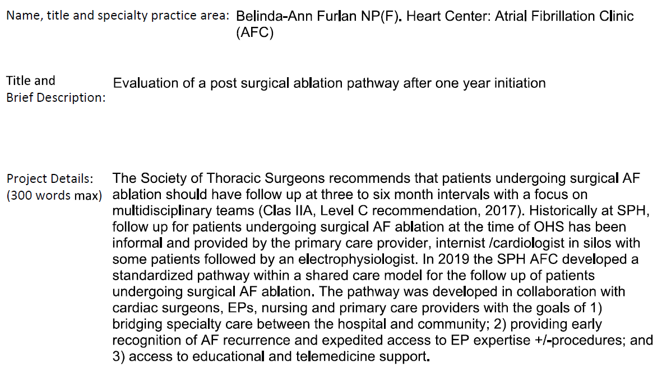
QUALITY, SAFETY & VALUE PROJECTS
Notes:
This initiative looked at improving the follow up for patients post surgical ablation through the use of a pathway where pts were followed up by an Nurse practitioner at 3 months and an EP at 1 year. The pathway goal was 1. bridging specialty are between the hospital and the community, 2. providing early recognition of AF recurrence and expediting care, and 3. access to educational and telemedicine support.
With one year follow up 86% of pt were followed on the pathway.

Slide 26
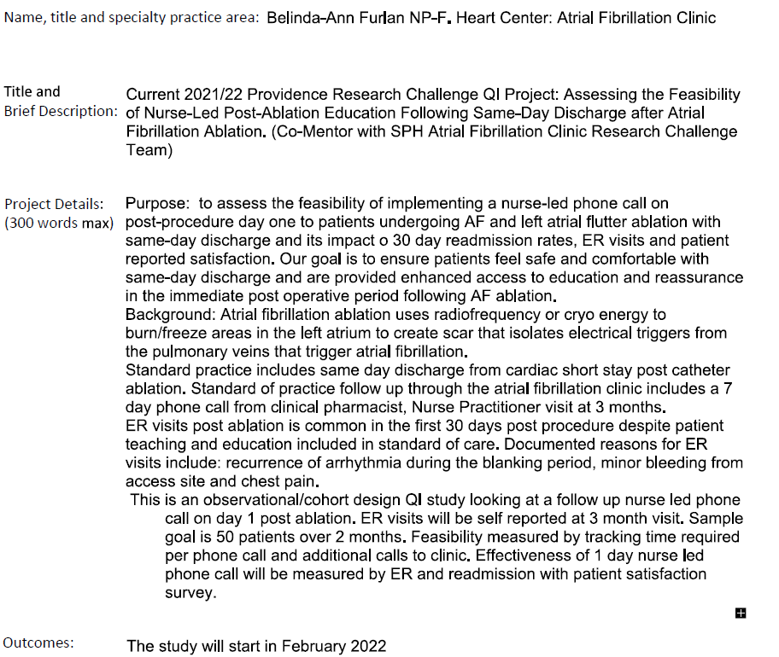
QUALITY, SAFETY & VALUE PROJECTS
Notes:
This project is part of the current research challenge. It looks at the feasibility of implementing nurse led post ablation procedure telephone follow up the day after discharge and the impact on 30 day readmission rates, ER visits and pt satisfaction. The study will start on February 2022.

Slide 27
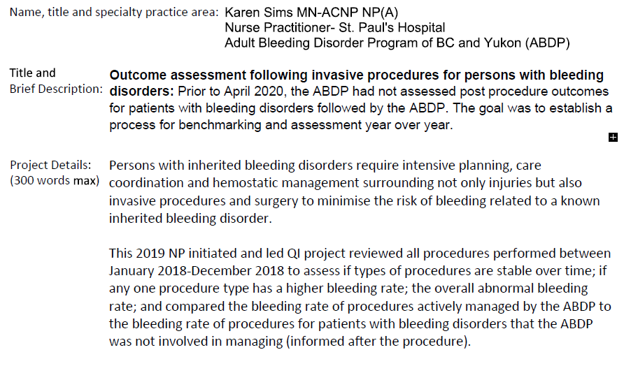
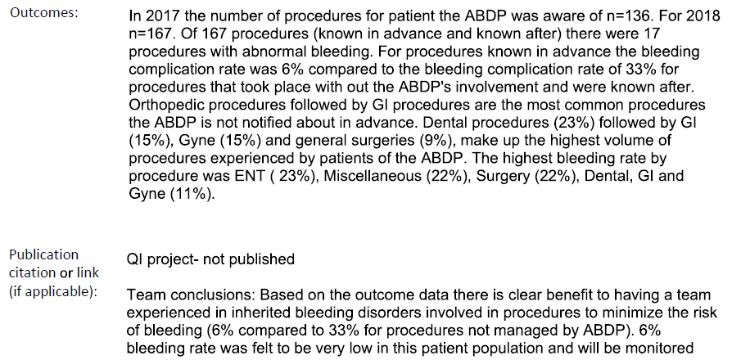
QUALITY, SAFETY & VALUE PROJECTS

Slide 28
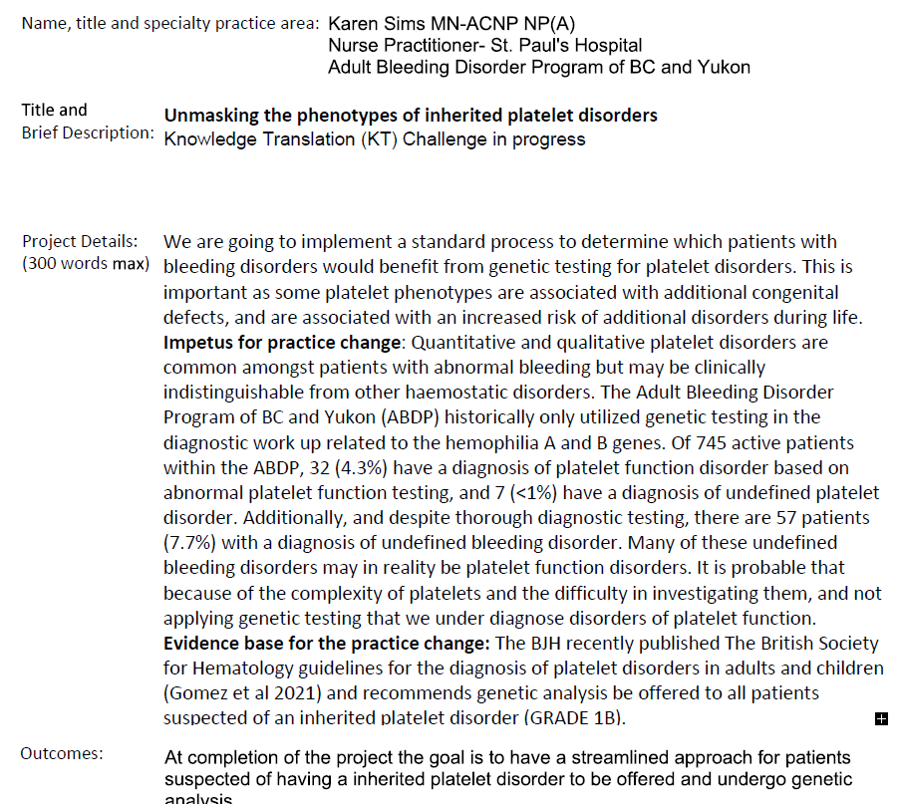
QUALITY, SAFETY & VALUE PROJECTS

Slide 29
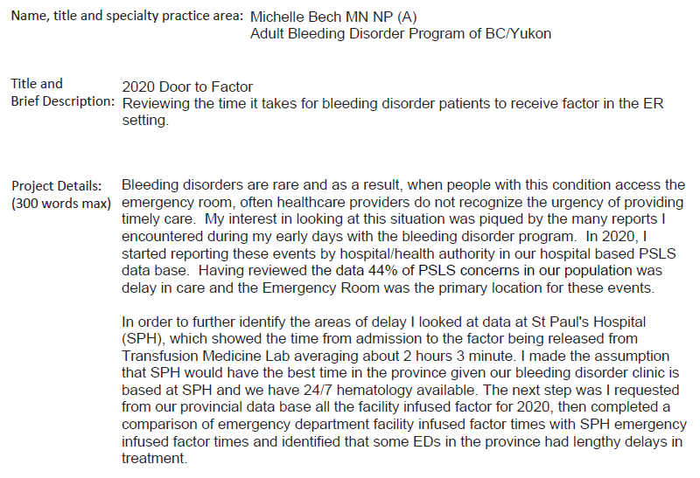
QUALITY, SAFETY & VALUE PROJECTS

Slide 30
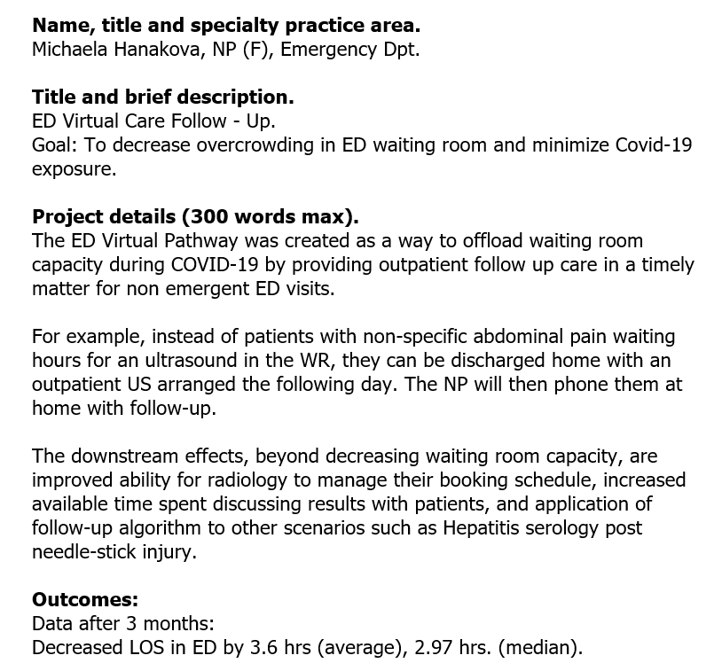
QUALITY, SAFETY & VALUE PROJECTS

Slide 31
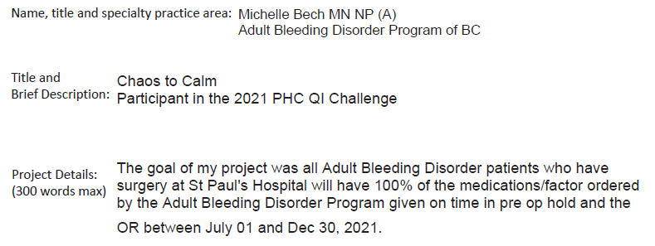
QUALITY, SAFETY & VALUE PROJECTS
Notes:
This project looked at the timeliness of medication administration for persons with bleeding disorders undergoing surgery at SPH.

Slide 32
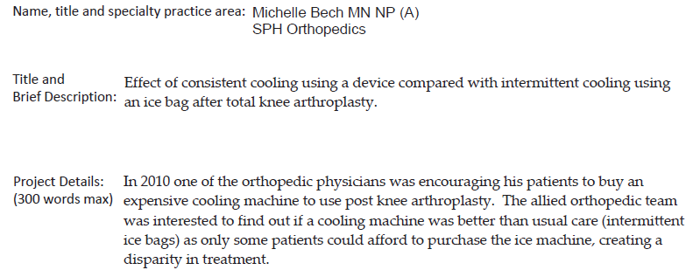
QUALITY, SAFETY & VALUE PROJECTS

Slide 33
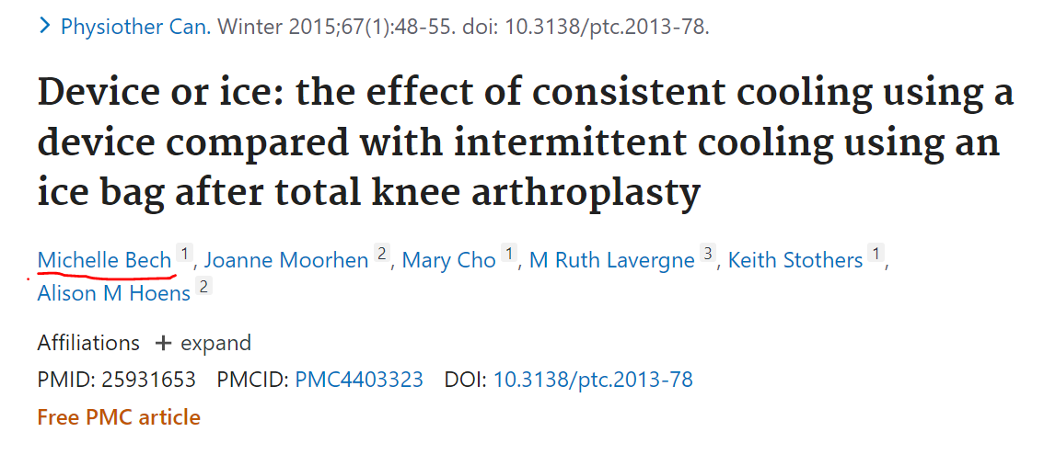
PUBLICATIONS
The study found no additional benefit of consistent cryotherapy.
With the results the team determined that usual knee arthroplasy care was not substandard and it was not necessary for patients to purchase the ice machines.

Slide 34
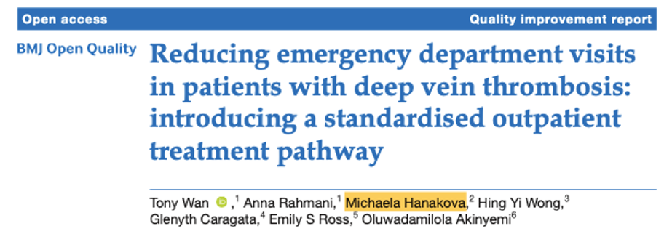
PUBLICATIONS
Result showed that a standardised DVT treatment pathway supported by an established thrombosis clinic was associated with a 50% reduction in the average monthly number of ED visits for DVT at SPH over 1year.
Notes:
Just published in 2020.

Slide 35
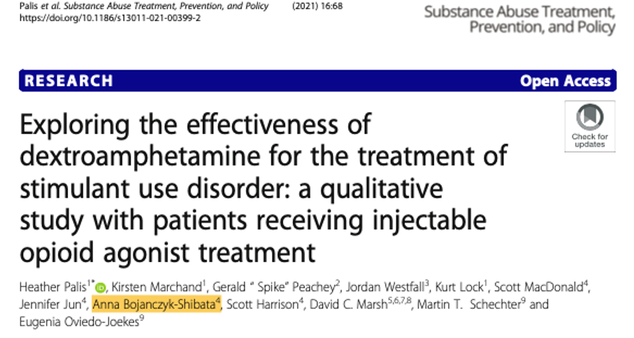
PUBLICATIONS
Notes:
Just published 2021- very timely research in the opioid crisis.

Slide 36
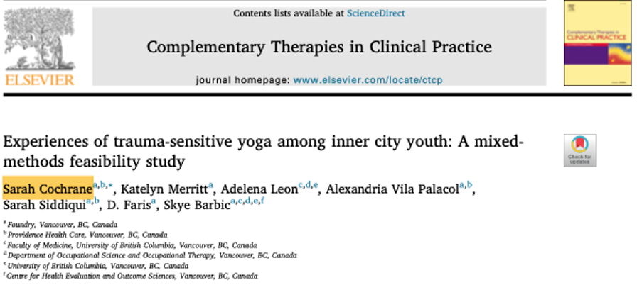
PUBLICATIONS
The findings suggest TSY training enriched their practices, chiefly through its choice-based, widely applicable approach; invitation- and mindfulness-based language; and building of therapeutic trust and attunement.

Slide 37
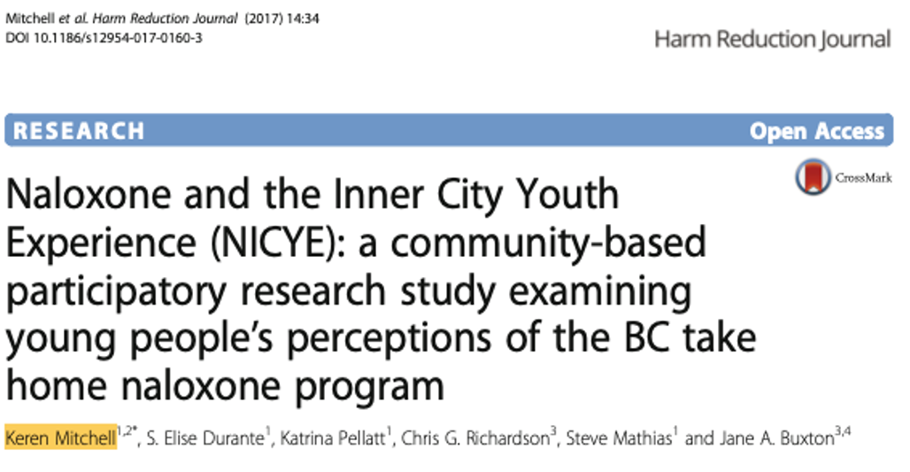
PUBLICATIONS
Young people perceived THN training as a positive experience that improved relationships with staff. Participant recommendations for quality improvement were implemented within the provincial program.

Slide 38
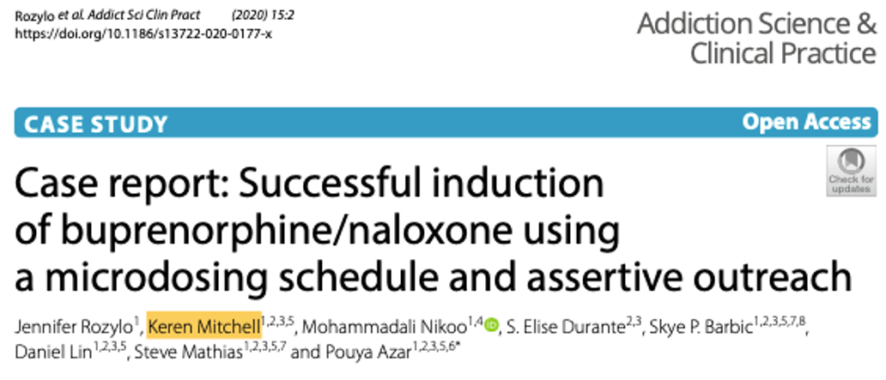
PUBLICATIONS
A microdosing schedule can be used to induce a patient onto buprenorphine/naloxone with no apparent withdrawal; gradually reducing illicit substance use. This case report builds on previous literature, highlighting ways to minimize barriers to induction of buprenorphine/naloxone, using a microdosing schedule and assertive outreach.

Slide 39
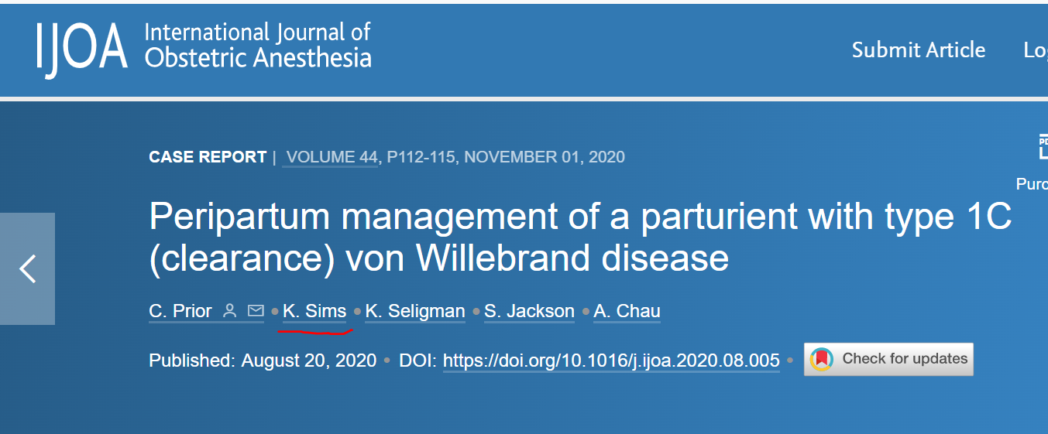
PUBLICATIONS
This co-authored case study came from a collaboration across teams and facilities for the benefit of patient centered care

Slide 41
PUBLICATIONS

Slide 42
RESEARCH CHALLENGE PARTICIPANTS
Year | Nurse Practitioner | Position | Project title
2021 | Belinda-Ann Furlan | Member | Nurse-led follow up protocol Afib discharge
2018 | Cindy Nordquist Micheala Hanakova | Leader Member | Harm reduction in HF patients
2018 | Melissa Mailey | Member | Post Op Delirium cardiac inpatients
2018 | Chelsea Bruce | Member | VitD status in renal post transplant
2016 | Stan Marchuk | Member | Monitoring tool to prevent infection
2016 | Sarah Cochrane | Leader | Trauma-sensitive yoga program
2014 | Keren Mitchell | Member | Evaluate take home naloxone
2012 | Stan Marchuk | Member | Enhancing in-centre hemodialysis pts’ self care

Slide 43
THANK YOU

